Slide 1
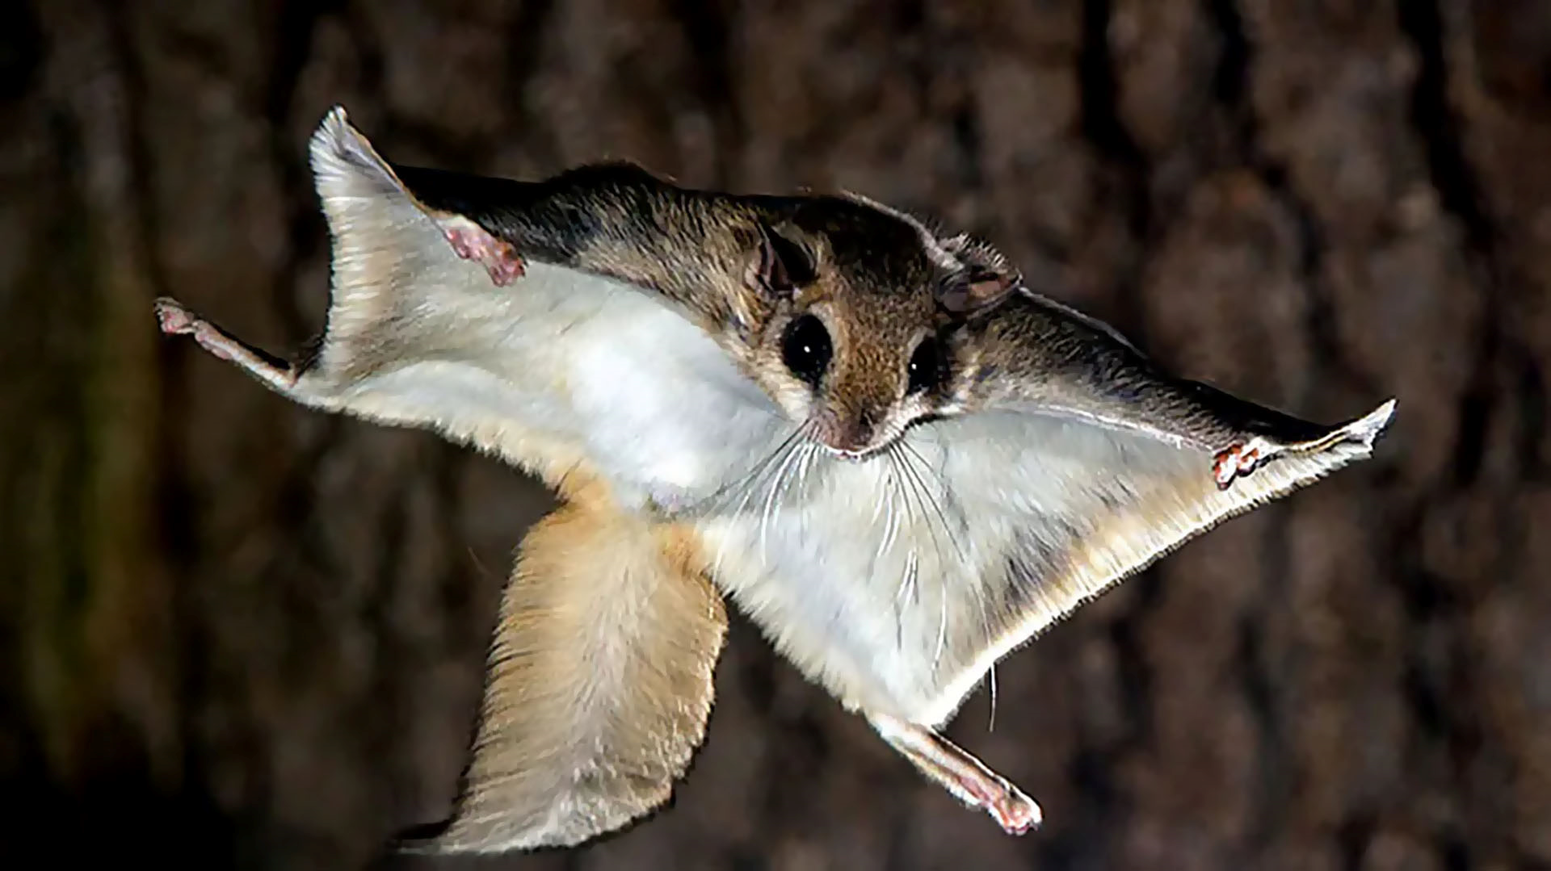




Flying Squirrel
Jonathan Avila, Ryan Donnellan, Justin Joy, Owen Kehl, Joey Mathews

Slide 2

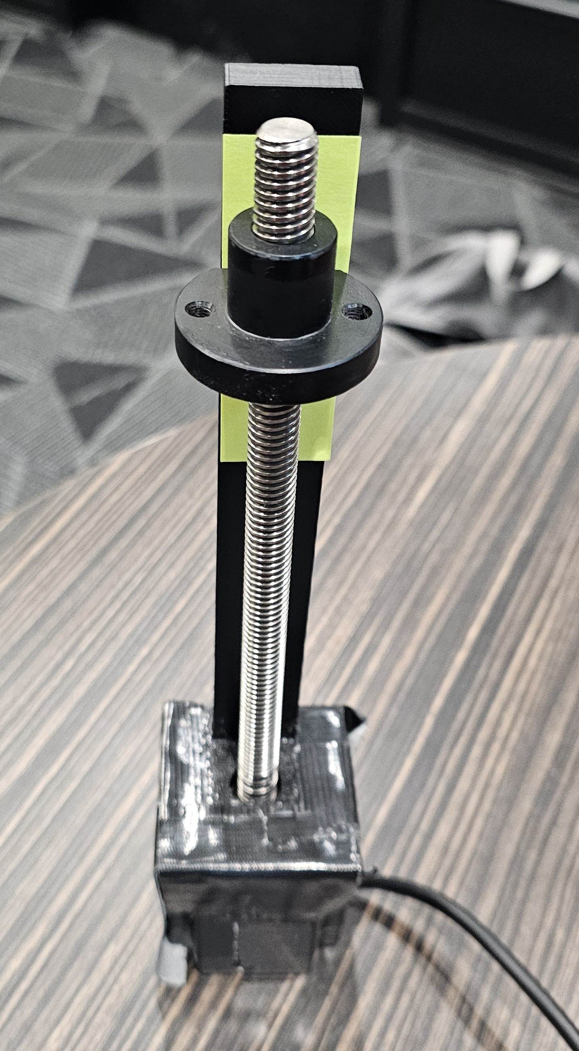
Sub System Prototype 1
Motor and lead screw supplied by Dr. Razavian
3D printed fixture combines the components; prevents nut from rotating freely
Question(s) this prototype answered:
Is the screw lifting system feasible for our design?
Figure 1: Partial Lifting Assembly

Slide 3
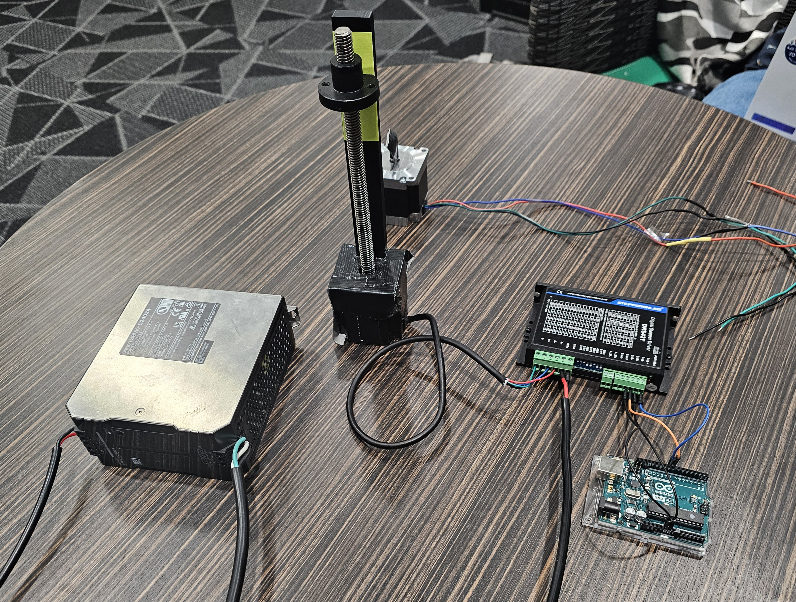
Sub-System Prototype 2
Components provided by Dr. Razavian
Features a 24V DC power supply, a stepper motor and stepper driver
Controlled by Arduino
Question(s) this simulation answered:
How do we incorporate a motor driver into the code?
How do we create a circuit using the necessary components to successfully power and control the motors?
Figure 2: Completed Lifting Motor Circuit

Slide 4
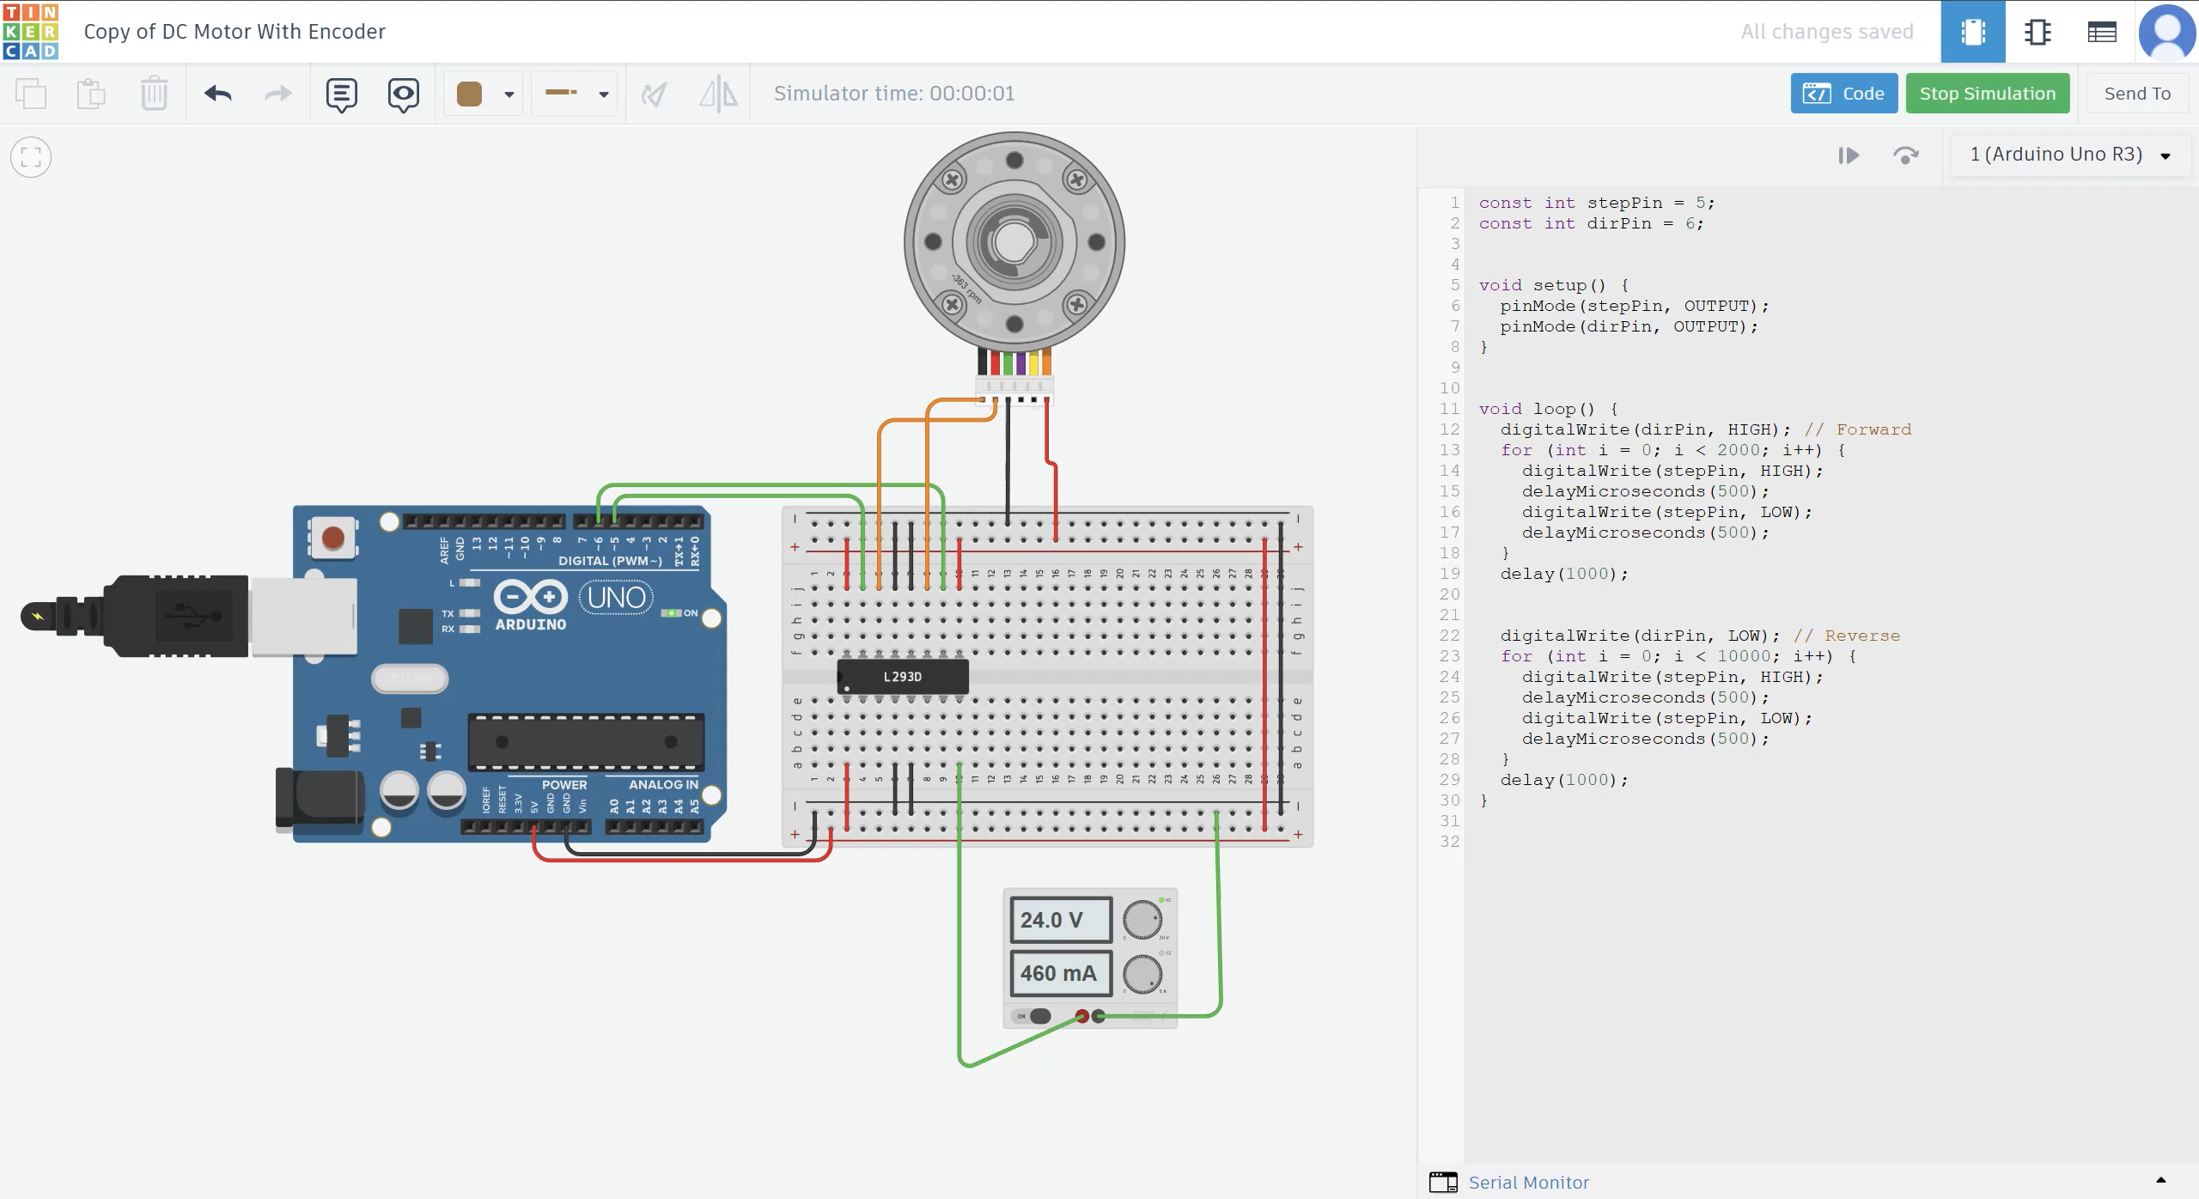
Virtual Prototype
Simulation uses an H-bridge connecter in place of motor controller
Circuit created by breeno3
Motor controller used for real prototype has malfunctioning B-coil output resulting in no movement
Question(s) this simulation answered:
Does the code used for direction of motor work as intended?
Figure 3: Motor Circuit Simulation

Slide 5
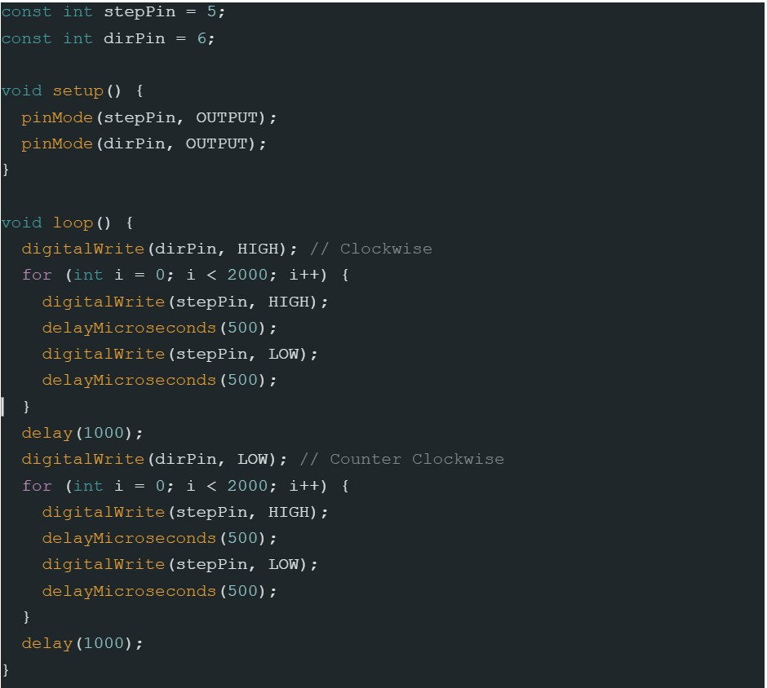
Code
Figure 4: Motor Control Code
Notes:
Specify fundraising.

Slide 6
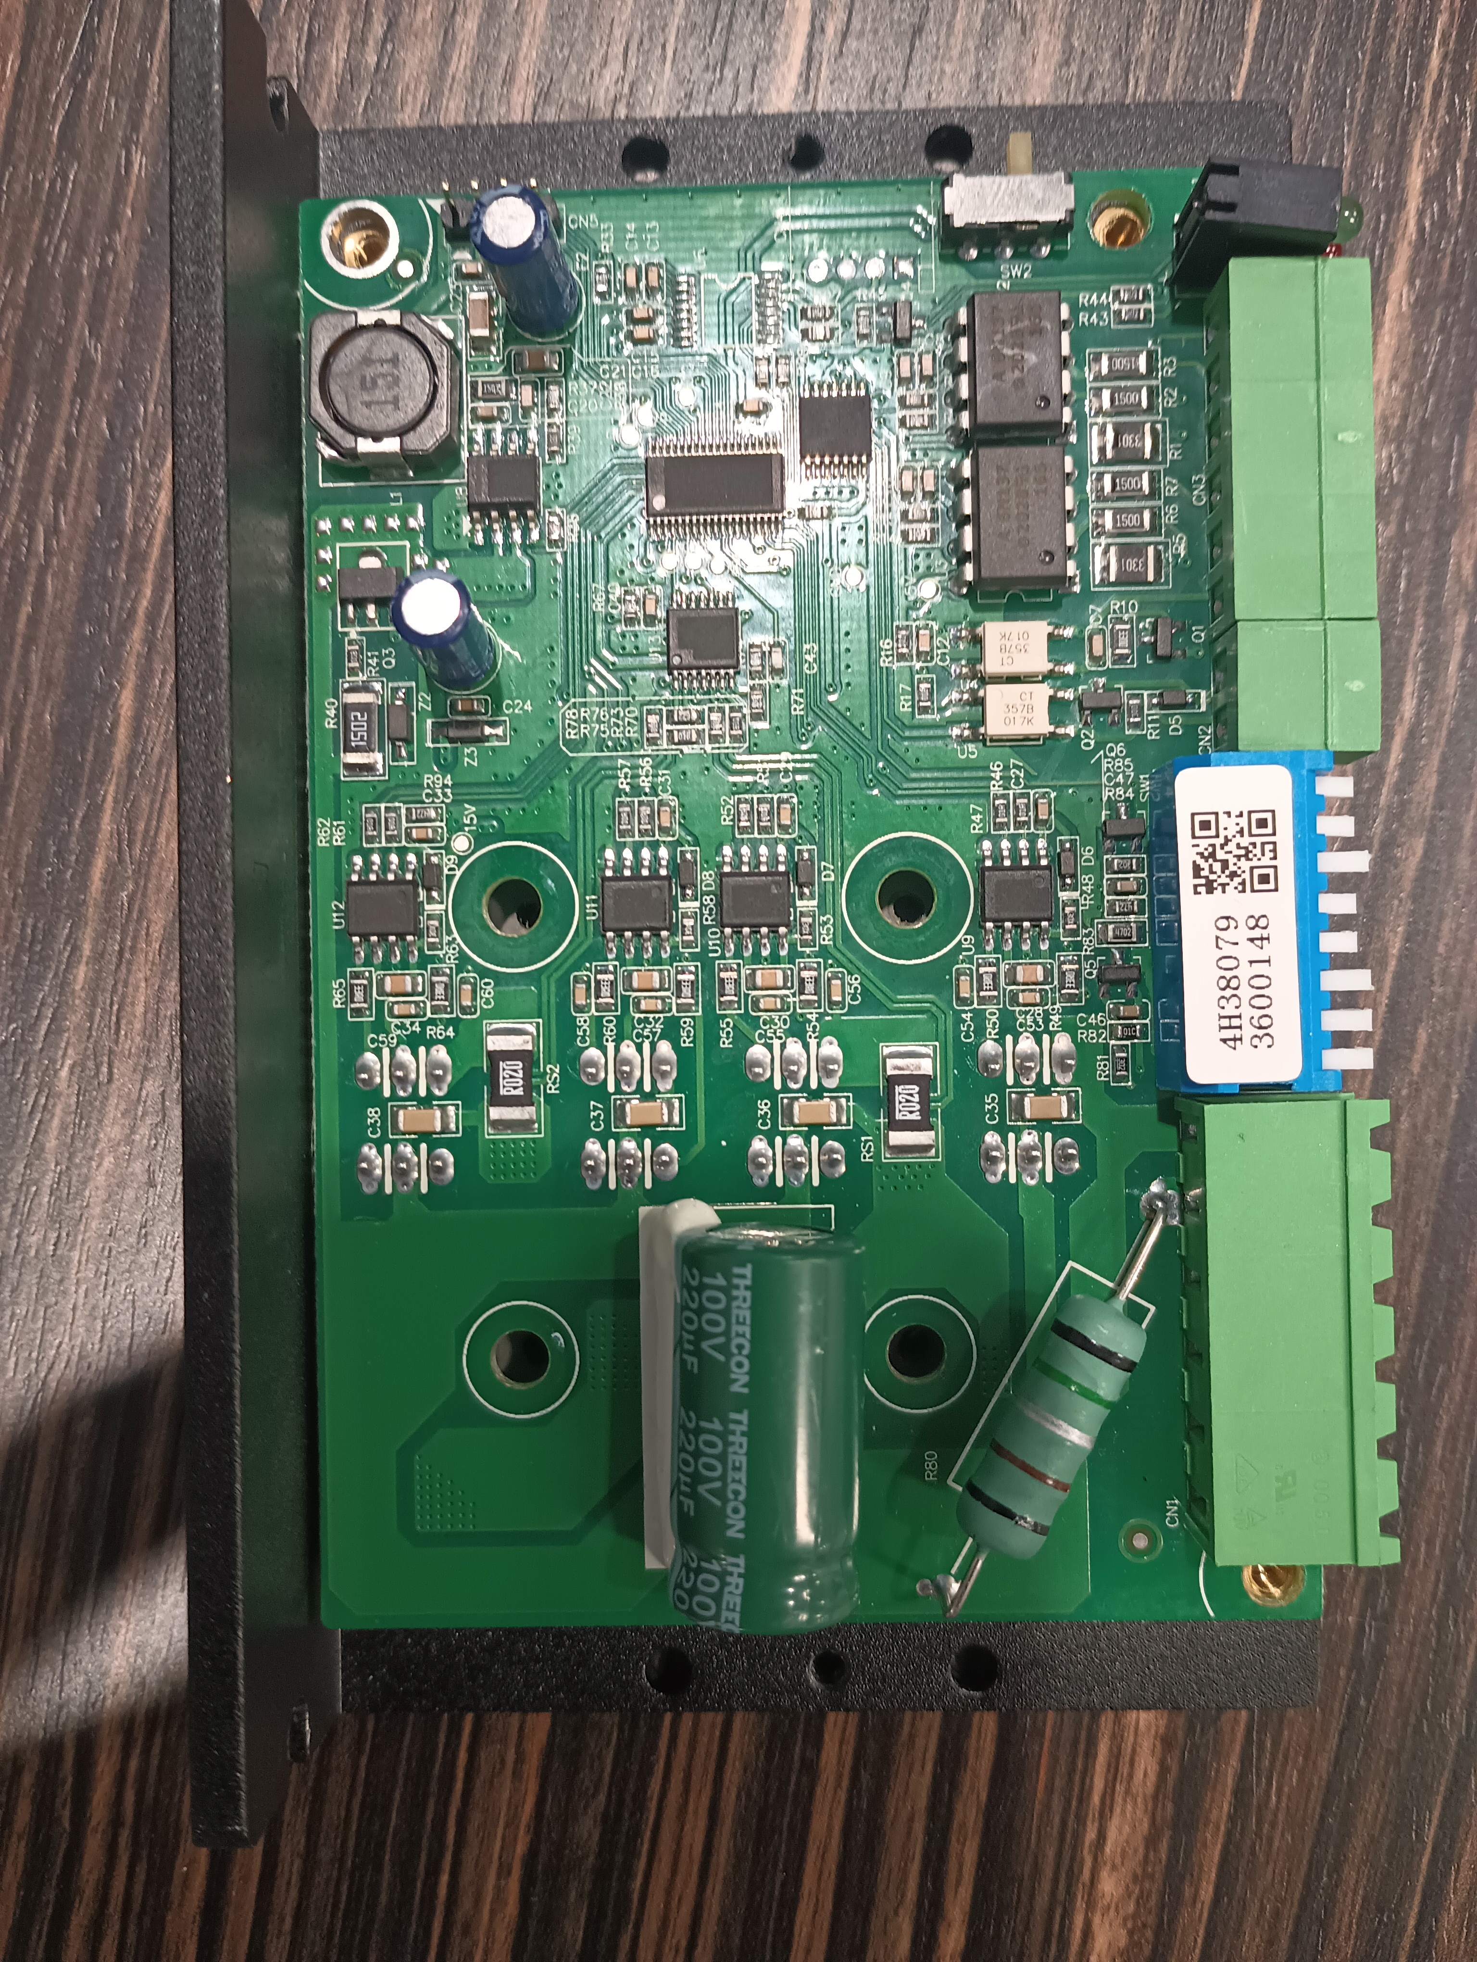
Potential Errors
The Issue
Possible Causes​
The motor driver given to us by Dr. Razavian had a faulty output port for the motor's second coil. The circuit was set up correctly, and it would have operated as intended under normal circumstances.
These issues could have possibly been damaged during its last use, whether by pushing too much current through it, extended duration of use, or a faulty motor was used.
Another possible issue is that it may have been disassembled previously and handled incorrectly, which could have damaged the board.
Resulting output voltage from motor driver
Channel A +20V
Channel B -15mV
Figure 5: Faulty Motor Driver Internals
Notes:
Specify fundraising.

Slide 7
Conclusion
Results
Design Adaptation
The screw design should work for our purposes
We now have the most basic circuit design to control our motors
Our code to control the motors works (Both directions) and can control speed
Research common issues in motor drivers and test all physical components
Use fundamental circuit design in our robot (With different components)
Notes:
Specify fundraising.

Slide 8
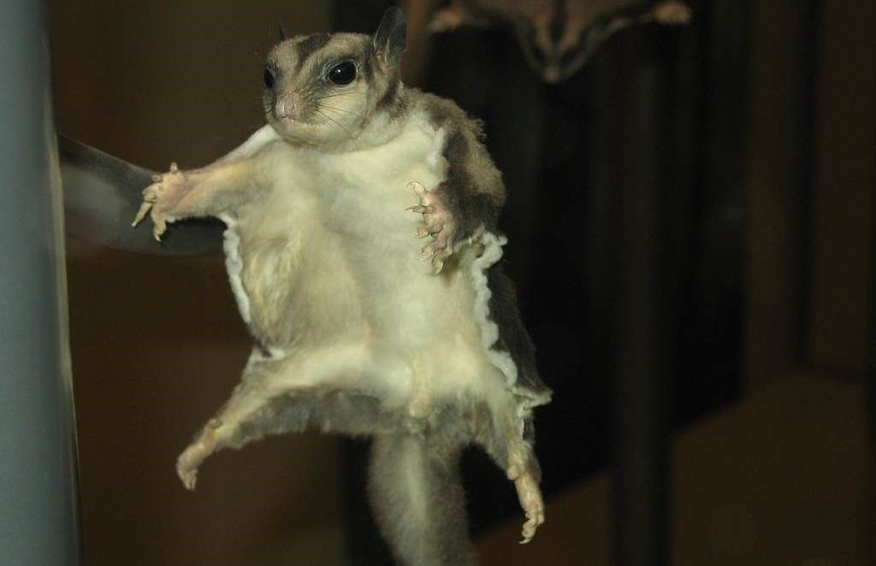


Thank You!

Slide 9
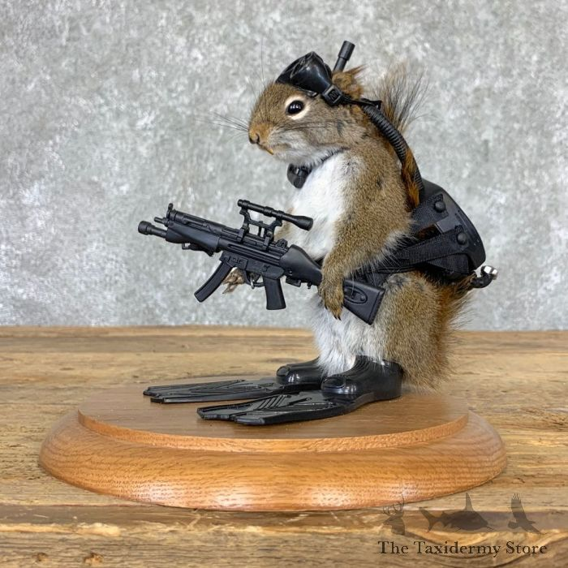
Resources
[1] Tinkercad, https://www.tinkercad.com/ (accessed Apr. 28, 2025).
[2] “Circuit design DC motor with encoder,” Tinkercad, https://www.tinkercad.com/things/5XmfSjHGIoF-dc-motor-with-encoder (accessed Apr. 28, 2025).

Slide 10
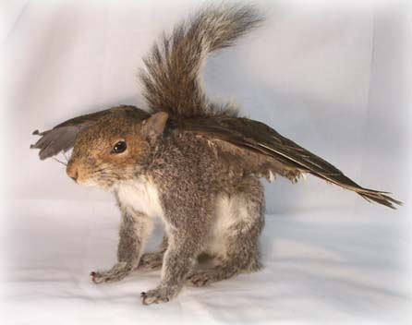
Question?

